Slide 1

KEEP OUT KEEP OUT KEEP OUT KEEP OUT KEEP OUT KEEP OUT KEEP OUT KEEP OUT KEEP OUT KEEP OUT KEEP OUT
KEEP OUT KEEP OUT KEEP OUT KEEP CHOI KEEP OUT KEEP OUT KEEP OUT KEEP OUT KEEP OUT KEEP OUT KEEP OUT
2021부산일과고 MATHCOM
KEEP OUT KEEP OUT KEEP OUT KEEP OUT KEEP OUT KEEP OUT KEEP OUT KEEP OUT KEEP OUT KEEP OUT KEEP OUT

Slide 2
KEEP OUT KEEP OUT KEEP OUT KEEP OUT KEEP OUT KEEP OUT KEEP OUT KEEP OUT KEEP OUT KEEP OUT KEEP OUT
도둑이 틱택토 마을의 우승 트로피를 훔쳐갔다!!
경찰은 트로피를 무사히 회수할 것인가?
아니면 도둑이 트로피를 가지고 도망칠 것인가??!!

Slide 3
KEEP OUT KEEP OUT KEEP OUT KEEP OUT KEEP OUT KEEP OUT KEEP OUT KEEP OUT KEEP OUT KEEP OUT KEEP OUT

Slide 4
KEEP OUT KEEP OUT KEEP OUT KEEP OUT KEEP OUT KEEP OUT KEEP OUT KEEP OUT KEEP OUT KEEP OUT KEEP OUT

Slide 5
KEEP OUT KEEP OUT KEEP OUT KEEP OUT KEEP OUT KEEP OUT KEEP OUT KEEP OUT KEEP OUT KEEP OUT KEEP OUT

Slide 6
KEEP OUT KEEP OUT KEEP OUT KEEP OUT KEEP OUT KEEP OUT KEEP OUT KEEP OUT KEEP OUT KEEP OUT KEEP OUT

Slide 7
KEEP OUT KEEP OUT KEEP OUT KEEP OUT KEEP OUT KEEP OUT KEEP OUT KEEP OUT KEEP OUT KEEP OUT KEEP OUT

Slide 8
KEEP OUT KEEP OUT KEEP OUT KEEP OUT KEEP OUT KEEP OUT KEEP OUT KEEP OUT KEEP OUT KEEP OUT KEEP OUT

Slide 9
KEEP OUT KEEP OUT KEEP OUT KEEP OUT KEEP OUT KEEP OUT KEEP OUT KEEP OUT KEEP OUT KEEP OUT KEEP OUT

Slide 10
KEEP OUT KEEP OUT KEEP OUT KEEP OUT KEEP OUT KEEP OUT KEEP OUT KEEP OUT KEEP OUT KEEP OUT KEEP OUT

Slide 11
KEEP OUT KEEP OUT KEEP OUT KEEP OUT KEEP OUT KEEP OUT KEEP OUT KEEP OUT KEEP OUT KEEP OUT KEEP OUT

Slide 12
KEEP OUT KEEP OUT KEEP OUT KEEP OUT KEEP OUT KEEP OUT KEEP OUT KEEP OUT KEEP OUT KEEP OUT KEEP OUT
4×4 판으로 게임!

Slide 13
KEEP OUT KEEP OUT KEEP OUT KEEP OUT KEEP OUT KEEP OUT KEEP OUT KEEP OUT KEEP OUT KEEP OUT KEEP OUT
코드 설명 시작

Slide 14
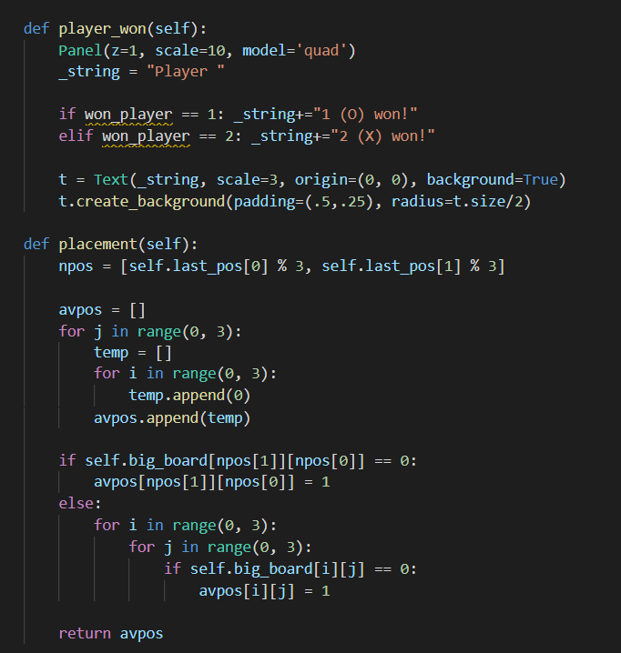
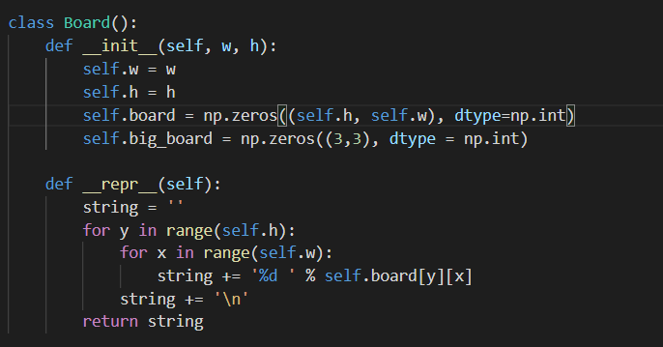
KEEP OUT KEEP OUT KEEP OUT KEEP OUT KEEP OUT KEEP OUT KEEP OUT KEEP OUT KEEP OUT KEEP OUT KEEP OUT
UI 설정

Slide 15
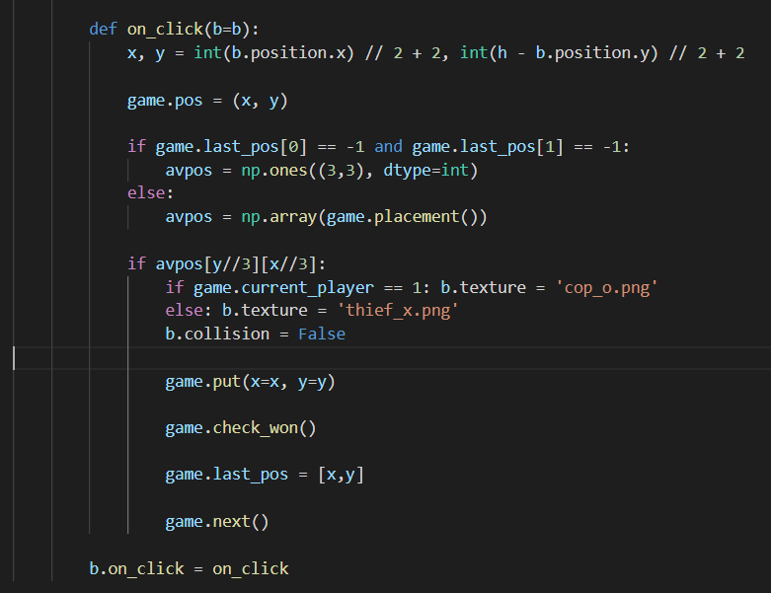
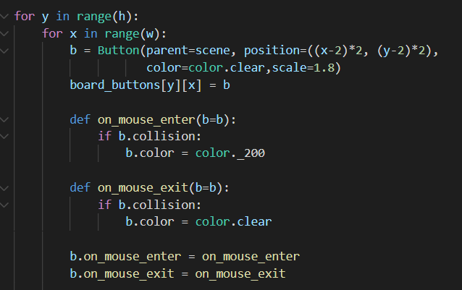
KEEP OUT KEEP OUT KEEP OUT KEEP OUT KEEP OUT KEEP OUT KEEP OUT KEEP OUT KEEP OUT KEEP OUT KEEP OUT
입출력

Slide 16
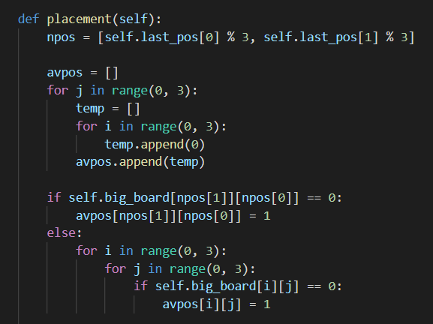
KEEP OUT KEEP OUT KEEP OUT KEEP OUT KEEP OUT KEEP OUT KEEP OUT KEEP OUT KEEP OUT KEEP OUT KEEP OUT
예외 처리

Slide 17
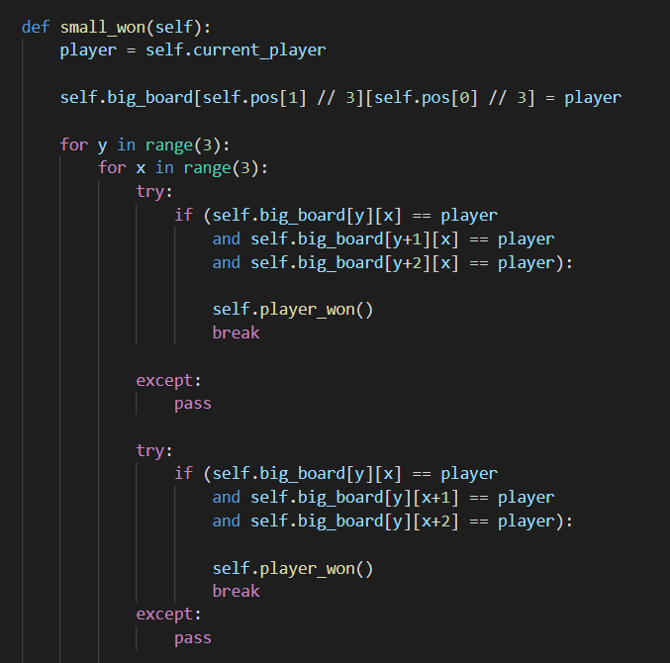
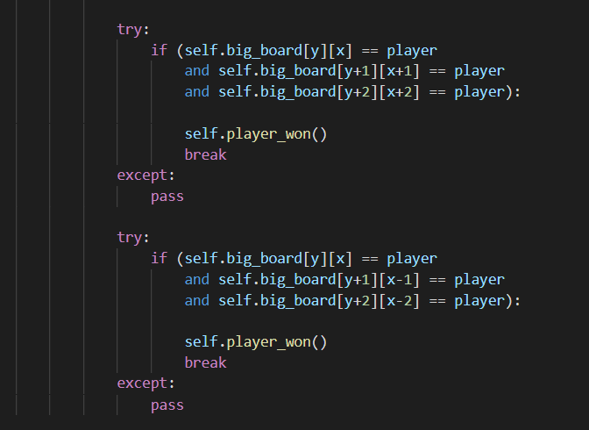
KEEP OUT KEEP OUT KEEP OUT KEEP OUT KEEP OUT KEEP OUT KEEP OUT KEEP OUT KEEP OUT KEEP OUT KEEP OUT
승패 결정 1

Slide 18
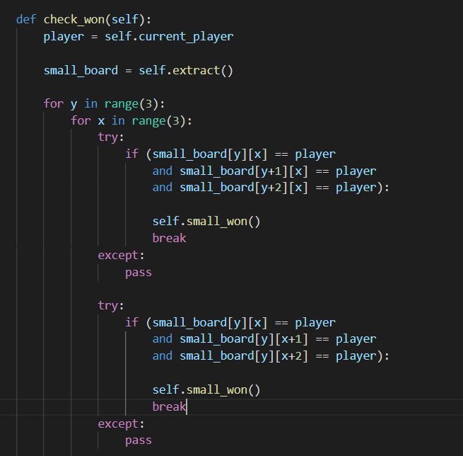
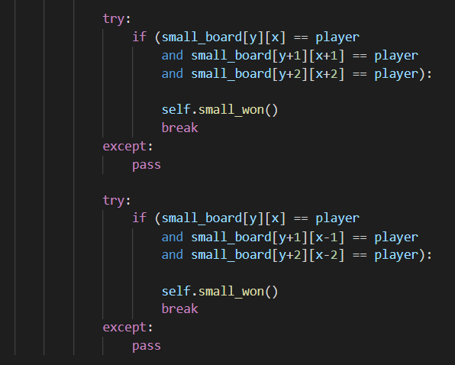
KEEP OUT KEEP OUT KEEP OUT KEEP OUT KEEP OUT KEEP OUT KEEP OUT KEEP OUT KEEP OUT KEEP OUT KEEP OUT
승패 결정 2

Slide 19
KEEP OUT KEEP OUT KEEP OUT KEEP OUT KEEP OUT KEEP OUT KEEP OUT KEEP OUT KEEP OUT KEEP OUT KEEP OUT
9×9 판으로 게임!

Slide 20
KEEP OUT KEEP OUT KEEP OUT KEEP OUT KEEP OUT KEEP OUT KEEP OUT KEEP OUT KEEP OUT KEEP OUT KEEP OUT

Slide 21
KEEP OUT KEEP OUT KEEP OUT KEEP OUT KEEP OUT KEEP OUT KEEP OUT KEEP OUT KEEP OUT KEEP OUT KEEP OUT

